Slide 1

Greedy Method
Presented by:
Elizer Ponio Jr.
Department of Computer Science
College of Computing and Information Technologies

Slide 2
Outline
Introduction
When to use a Greedy Algorithm?
Problems that can be solved by a Greedy method
Knapsack Problem
Huffman Coding

Slide 3
Introduction
A greedy algorithm is an approach for solving a problem by selecting the best option available at the moment.
Take the best solution you can get right now, without thinking of past record or future consequences. Hence the word ‘greedy’.
It doesn't worry whether the current best result will bring the overall optimal result.

Slide 4
Introduction
The algorithm never reverses the earlier decision even if the choice is wrong. It works in a top-down approach.
This algorithm may not produce the best result for all the problems. It's because it always goes for the local best choice to produce the global best result.

Slide 5
When to use a Greedy Algorithm?
If both of the properties are true, a greedy algorithm can be used to solve the problem.
Greedy choice property
A global (overall) optimal solution can be reached by choosing the optimal choice at each step.
Optimal substructure
A problem has an optimal substructure if an optimal solution to the entire problem contains the optimal solutions to the sub-problems.

Slide 6
Problems that can be solved by a Greedy method
Traveling one place to another weighing cost and travel time
Best car selection based on features
Giving a change by using the smallest number of coins
Knapsack problem
Activities selection problem

Slide 7
Giving a change by using the smallest number of coins
Problem:
Return/represent an amount of money, using the fewest possible coins.
Assume that you have only have coins of values {1, 5, 10, 20}, what would be the greedy approach to represent 36 with the fewest possible coins?

Slide 8
Giving a change by using the smallest number of coins
Create an empty solution-set = { }. Available coins are {20, 10, 5, 1}.
We are supposed to find the sum = 36. Let's start with sum = 0.
Always select the coin with the largest value until the sum > 36. (When we select the largest value at each step, we hope to reach the destination faster. This concept is called greedy choice property.)

Slide 9
Giving a change by using the smallest number of coins
In the first iteration, select 20. Solution-set = {20} and sum = 20.
In the second iteration, select 10. Solution-set = {20, 10} and sum = 30.
In the third iteration, select 5. Solution-set = {20, 10, 5} and sum = 35.
In the fourth iteration, select 1. Solution-set = {20, 10, 5, 1} and sum = 36.

Slide 10
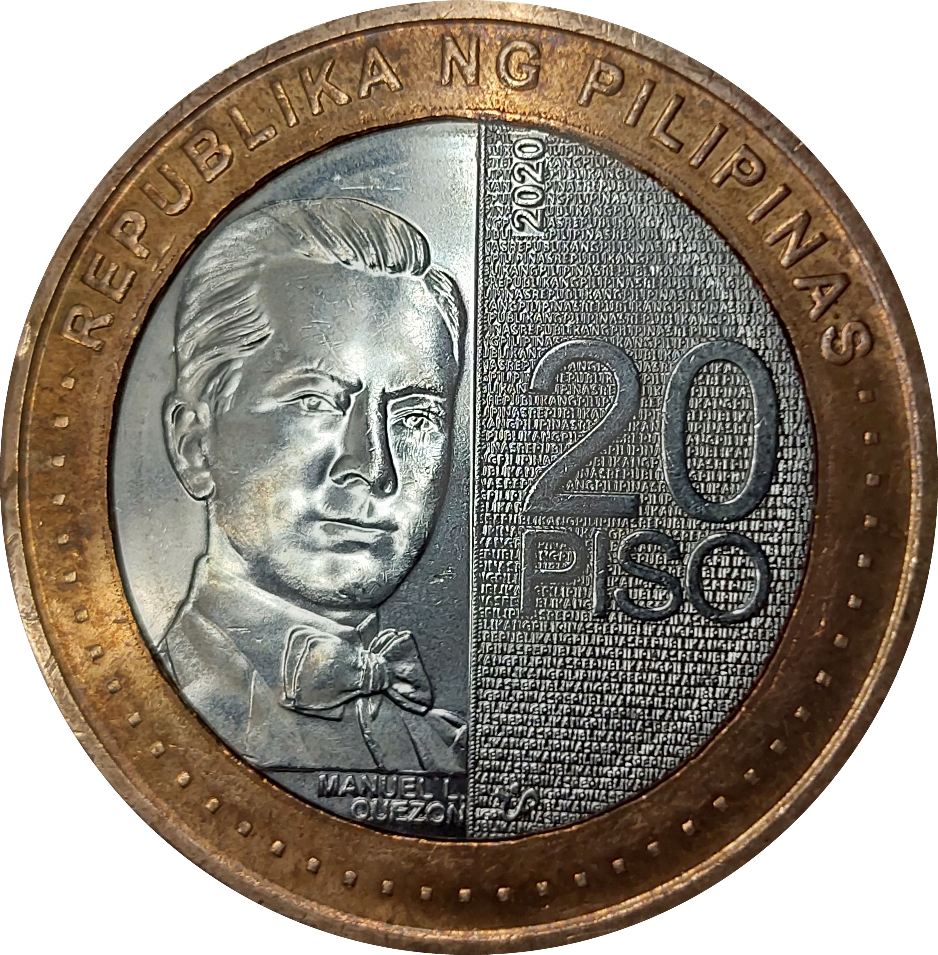
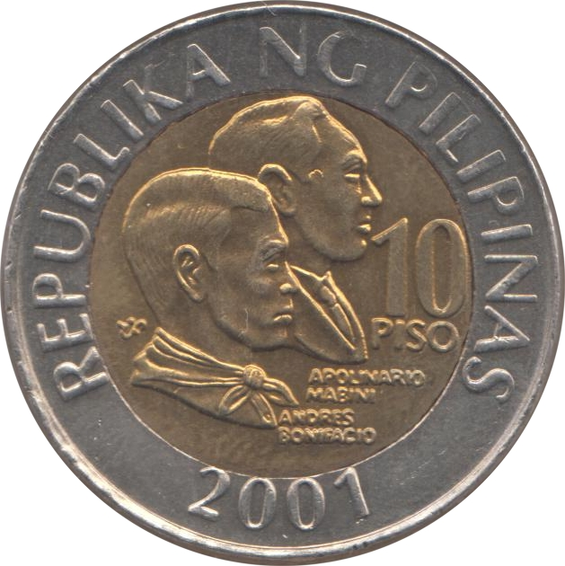
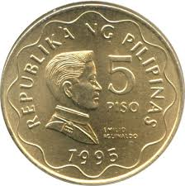
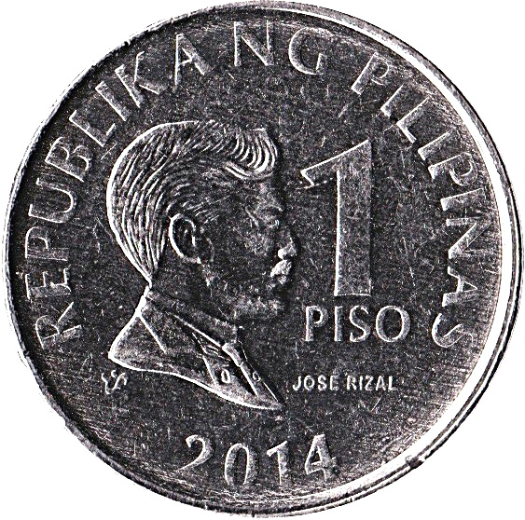
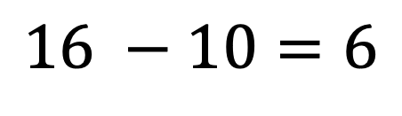
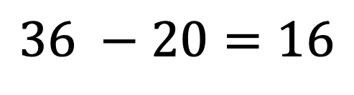
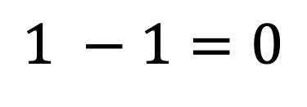
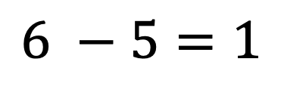
Problems that can be solved by a Greedy method
$$36 −20=16$$
$$16 −10=6$$
$$6 −5=1$$
$$1 −1=0$$

Slide 11
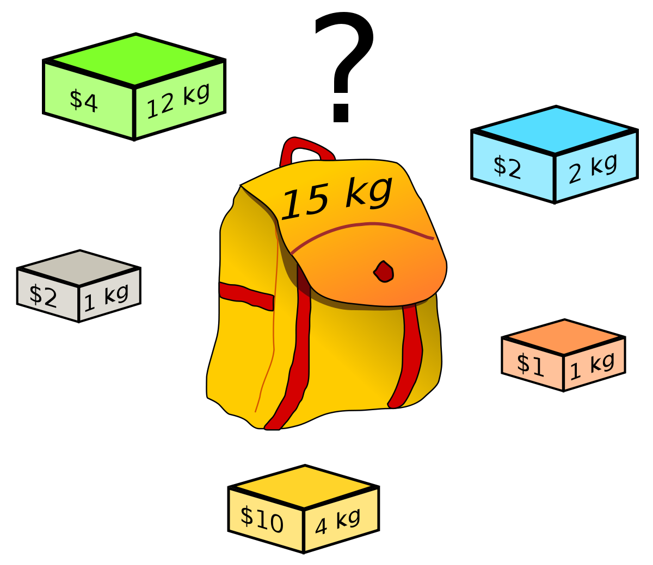
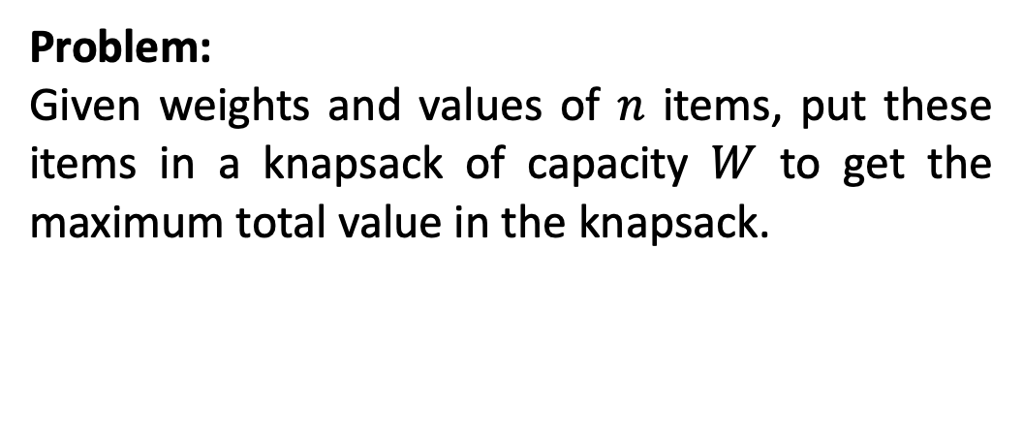
Knapsack Problem
Problem:
Given weights and values of $n$ items, put these items in a knapsack of capacity $W$ to get the maximum total value in the knapsack.

Slide 12

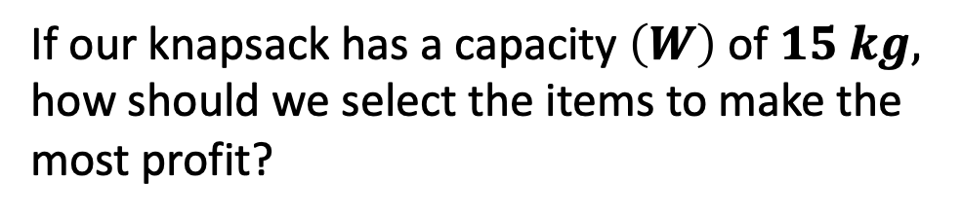
Knapsack Problem
Item Name | Smartwatch | Camera | Laptop | Bluetooth Speakers | Wireless Earphones | Phone | Charger
Value in $ | 10 | 5 | 15 | 7 | 6 | 18 | 3
Weight in kg | 2 | 3 | 5 | 7 | 1 | 4 | 1
If our knapsack has a capacity $\left(W\right)$ of $15 kg,$ how should we select the items to make the most profit?

Slide 13
Knapsack Problem
Item Name | Smartwatch | Camera | Laptop | Bluetooth Speakers | Wireless Earphones | Phone | Charger
Value in $ | 10 | 5 | 15 | 7 | 6 | 18 | 3
Weight in kg | 2 | 3 | 5 | 7 | 1 | 4 | 1
Greedy Solutions
Among the remaining items, grab the item with largest profit value that would fit in the knapsack.
Among the remaining items, grab the item with the largest value per weight that would fit in the knapsack.

Slide 14
Knapsack Problem
Item Name | Smartwatch | Camera | Laptop | Bluetooth Speakers | Wireless Earphones | Phone | Charger
Value in $ | 10 | 5 | 15 | 7 | 6 | 18 | 3
Weight in kg | 2 | 3 | 5 | 7 | 1 | 4 | 1
Value per weight | 5 | 1.3 | 3 | 1 | 6 | 4.5 | 3

Slide 15
Knapsack Problem
Item Name | Smartwatch | Camera | Laptop | Bluetooth Speakers | Wireless Earphones | Phone | Charger
Value in $ | 10 | 5 | 15 | 7 | 6 | 18 | 3
Weight in kg | 2 | 3 | 5 | 7 | 1 | 4 | 1
Value per weight | 5 | 1.3 | 3 | 1 | 6 | 4.5 | 3
Choose items starting with the highest value per weight until we reach the capacity $W$

Slide 16
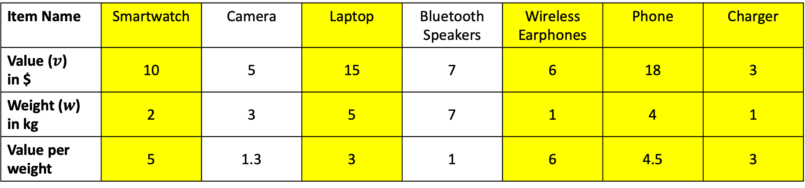
Item Name | Smartwatch | Camera | Laptop | Bluetooth Speakers | Wireless Earphones | Phone | Charger
Value ($v$) in $ | 10 | 5 | 15 | 7 | 6 | 18 | 3
Weight ($w$) in kg | 2 | 3 | 5 | 7 | 1 | 4 | 1
Value per weight | 5 | 1.3 | 3 | 1 | 6 | 4.5 | 3
Items in knapsack
Wireless earphones (1kg)
Smartwatch (2kg)
Phone (4kg)
Laptop (5kg)
Charger (1kg)
Total Weight = 13kg
Available = 2kg

Slide 17
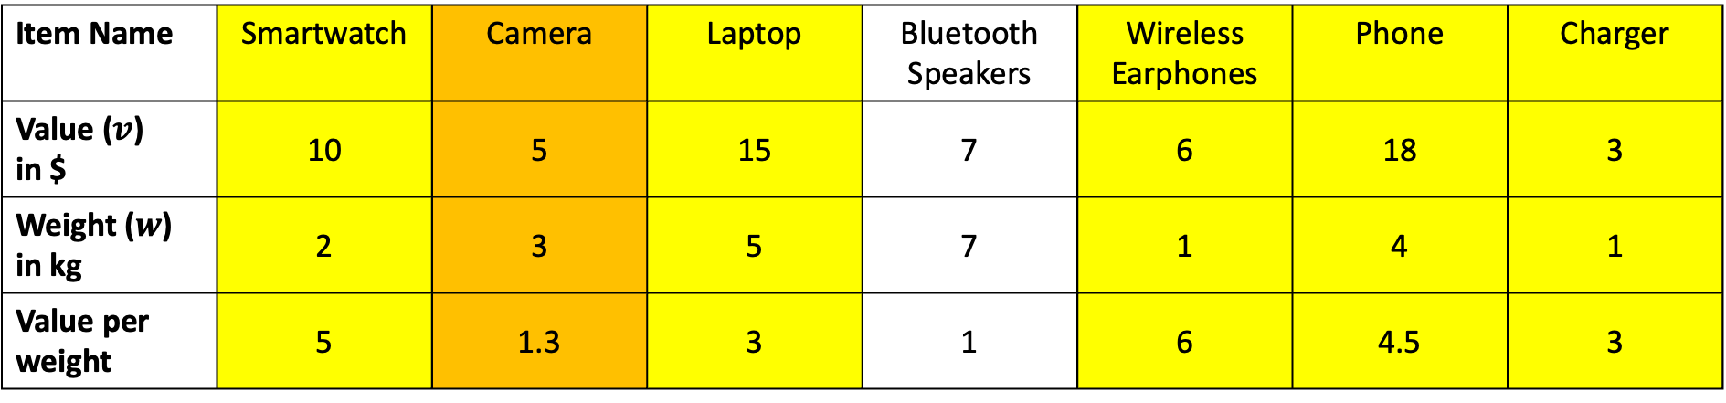
Item Name | Smartwatch | Camera | Laptop | Bluetooth Speakers | Wireless Earphones | Phone | Charger
Value ($v$) in $ | 10 | 5 | 15 | 7 | 6 | 18 | 3
Weight ($w$) in kg | 2 | 3 | 5 | 7 | 1 | 4 | 1
Value per weight | 5 | 1.3 | 3 | 1 | 6 | 4.5 | 3
Items in knapsack
Wireless earphones (1kg)
Smartwatch (2kg)
Phone (4kg)
Laptop (5kg)
Charger (1kg)
Total Weight = 13kg
Available = 2kg
In order to maximize the capacity of our knapsack, we can take the camera but we reduce its weight to 2kg (e.g removing the lens)

Slide 18
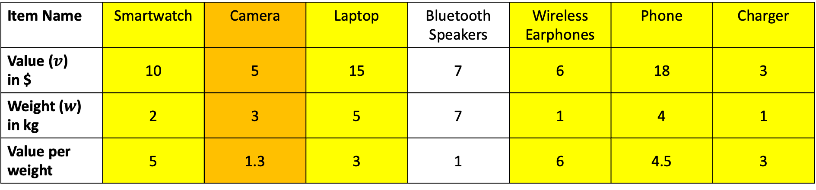
Knapsack Problem
Item Name | Smartwatch | Camera | Laptop | Bluetooth Speakers | Wireless Earphones | Phone | Charger
Value ($v$) in $ | 10 | 5 | 15 | 7 | 6 | 18 | 3
Weight ($w$) in kg | 2 | 3 | 5 | 7 | 1 | 4 | 1
Value per weight | 5 | 1.3 | 3 | 1 | 6 | 4.5 | 3
$$\sum{x_{i}w_{i}}=(1 × 2)+(\frac{2}{3}×3)+(1 × 5)+(0 × 7)+(1 × 1)+(1 × 4)+(1 × 1)$$
$$2+2+5+0+1+4+\left(1\right)=15$$

Slide 19
Knapsack Problem
Item Name | Smartwatch | Camera | Laptop | Bluetooth Speakers | Wireless Earphones | Phone | Charger
Value ($v$) in $ | 10 | 5 | 15 | 7 | 6 | 18 | 3
Weight ($w$) in kg | 2 | 3 | 5 | 7 | 1 | 4 | 1
Value per weight | 5 | 1.3 | 3 | 1 | 6 | 4.5 | 3
$$\sum{x_{i}v_{i}}=(1 × 10)+(\frac{2}{3}× 5)+(1 × 15)+(0 × 7)+(1 × 6)+(1 × 18)+(1 × 3)$$
$$10+3.33+15+0+6+18+3=55.33$$

Slide 20
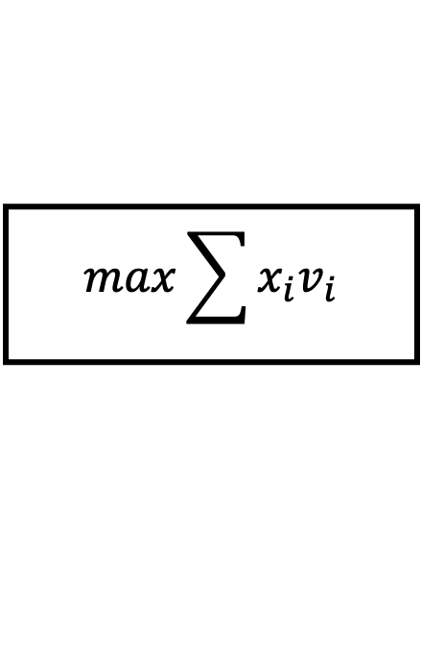
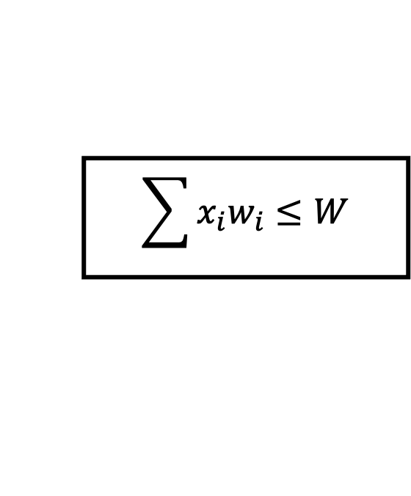
Knapsack Problem
Item Name | Smartwatch | Camera | Laptop | Bluetooth Speakers | Wireless Earphones | Phone | Charger
Value ($v$) in $ | 10 | 5 | 15 | 7 | 6 | 18 | 3
Weight ($w$) in kg | 2 | 3 | 5 | 7 | 1 | 4 | 1
Value per weight | 5 | 1.3 | 3 | 1 | 6 | 4.5 | 3
Constraint:
Objective:
$$\sum{x_{i}w_{i}}≤W$$
$$max\sum{x_{i}v_{i}}$$

Slide 21
Huffman Coding
Is a technique of compressing data to reduce its size without losing any of the details.
It was first developed by David Huffman.
Huffman Coding is generally useful to compress the data in which there are frequently occurring characters.

Slide 22
How Huffman Coding Works?
Suppose the string below is to be sent over a network.
B | C | C | A | B | B | D | D | A | E | C | C | B | B | A | E | D | D | C | C
Message Length = 20
In ASCII code, each letter has an 8-bit representation

Slide 23
Huffman Coding
Character | Decimal | Binary
A | 65 | 01000001
B | 66 | 01000010

Slide 24
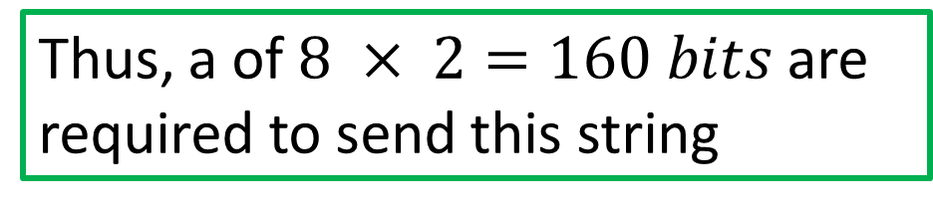
Huffman Coding
B | C | C | A | B | B | D | D | A | E | C | C | B | B | A | E | D | D | C | C
Message Length = 20
Thus, a of $8 × 2=160 bits$ are required to send this string
In ASCII code, each letter has an 8-bit representation

Slide 25
Huffman Coding
B | C | C | A | B | B | D | D | A | E | C | C | B | B | A | E | D | D | C | C
Character | Frequency | Code
A | 3 | 000
B | 5 | 001
C | 6 | 010
D | 4 | 011
E | 2 | 100

Slide 26
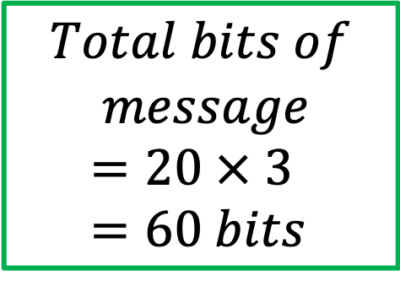
Compress String using Huffman Coding
B | C | C | A | B | B | D | D | A | E | C | C | B | B | A | E | D | D | C | C
Character | Frequency | Code
A | 3 | 000
B | 5 | 001
C | 6 | 010
D | 4 | 011
E | 2 | 100
$$Total bits of$$
$$message=20 × 3=60 bits$$

Slide 27
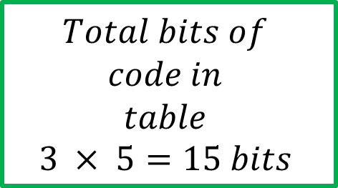
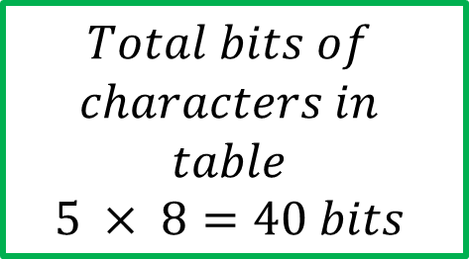
Compress String using Huffman Coding
B | C | C | A | B | B | D | D | A | E | C | C | B | B | A | E | D | D | C | C
Character | Frequency | Code
A | 3 | 000
B | 5 | 001
C | 6 | 010
D | 4 | 011
E | 2 | 100
$$Total bits of$$
$$characters in$$
$$table$$
$$5 × 8=40 bits$$
$$Total bits of$$
$$code in$$
$$table$$
$$3 × 5=15 bits$$

Slide 28





Compress String using Huffman Coding
B | C | C | A | B | B | D | D | A | E | C | C | B | B | A | E | D | D | C | C
E
A
D
B
C
$$2$$
$$3$$
$$4$$
$$5$$
$$6$$
0
1
0
1
5
11
1
0
9
1
0
20

Slide 29





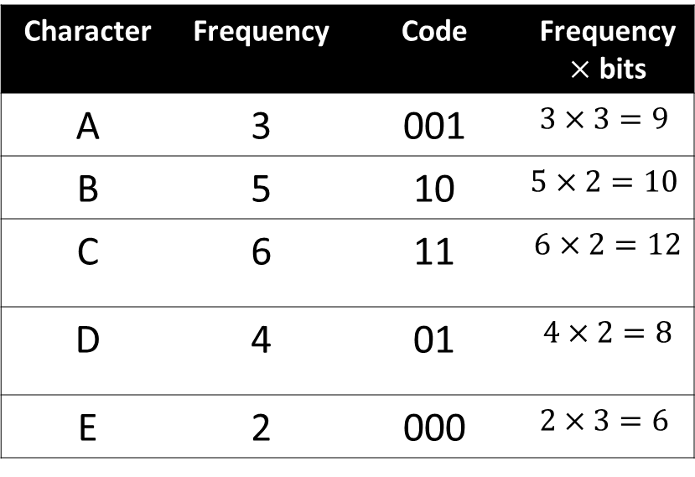
Compress String using Huffman Coding
E
A
D
B
C
Character | Frequency | Code | Frequency $×$ bits
A | 3 | 001 | $$3×3=9$$
B | 5 | 10 | $$5×2=10$$
C | 6 | 11 | $$6×2=12$$
D | 4 | 01 | $$4×2=8$$
E | 2 | 000 | $$2×3=6$$
$$2$$
$$3$$
$$4$$
$$5$$
$$6$$
0
1
0
1
5
11
1
0
9
1
0
20

Slide 30






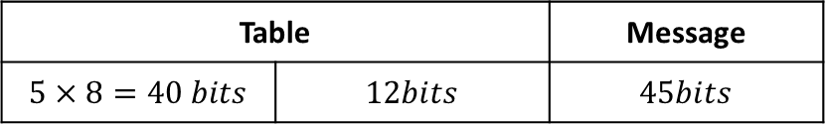


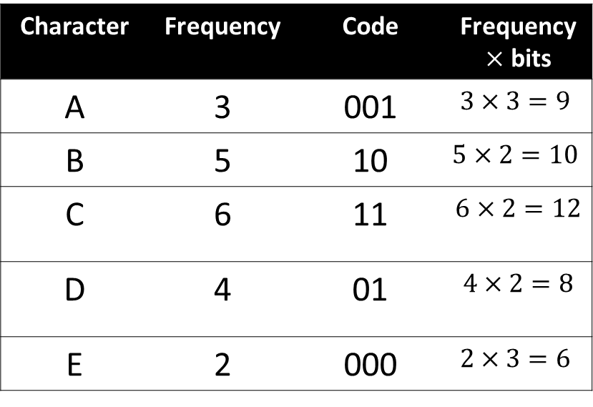

Compress String using Huffman Coding
Character | Frequency | Code | Frequency $×$ bits
A | 3 | 001 | $$3×3=9$$
B | 5 | 10 | $$5×2=10$$
C | 6 | 11 | $$6×2=12$$
D | 4 | 01 | $$4×2=8$$
E | 2 | 000 | $$2×3=6$$
Table |  | Message
$$5×8=40 bits$$ | $$12bits$$ | $$45bits$$
$$45 bits$$
$$+ 52 bits$$
$$97 bits$$

Slide 31

Huffman Coding
$$Total bits ofmessage=20 × 3=60 bits$$
$$Total bits ofcharacters in table=5 × 8=40 bits$$
$$Total bits of code in table=3 × 5=15 bits$$
$$Total bits =115 bits$$

Slide 32
References
https://www.programiz.com/dsa/huffman-coding
https://www.programiz.com/dsa/greedy-algorithm

